Slide 1
Http Networking
Indra Azimi, S.T., M.T.
D3 Teknik Informatika, Telkom University

Slide 2
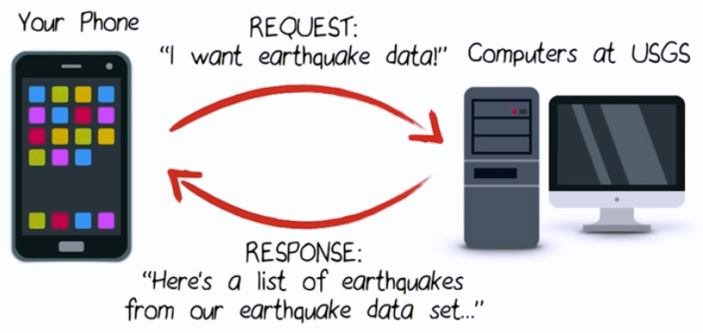
HTTP Request & Response
By default, an Android app does not have access to the internet.

Slide 3
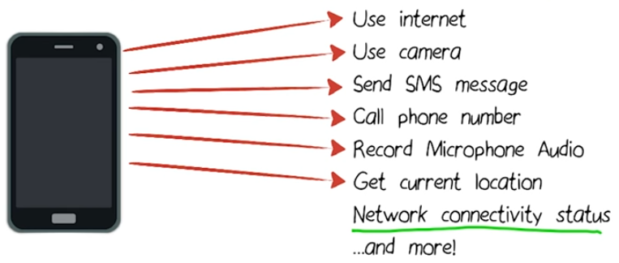
Permissions in Android
To maintain security for the system and users, Android requires apps to request permission before the apps can use certain system data and features.

Slide 4
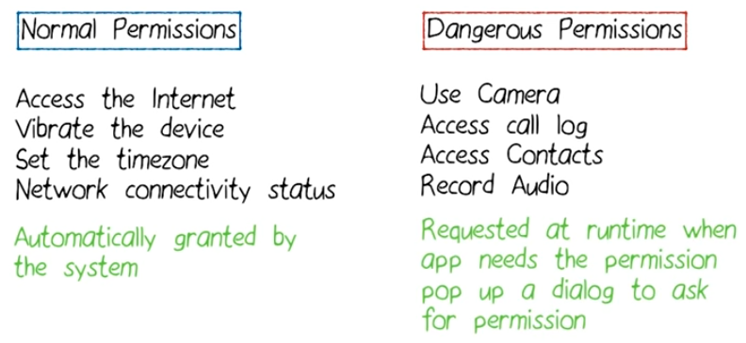
Level Of Permissions

Slide 5
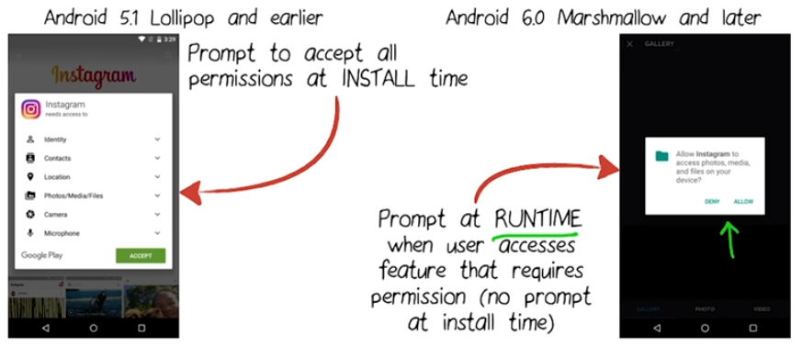
Backwards Compatibility

Slide 6
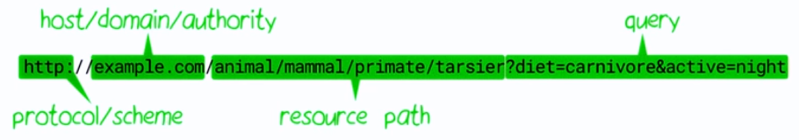
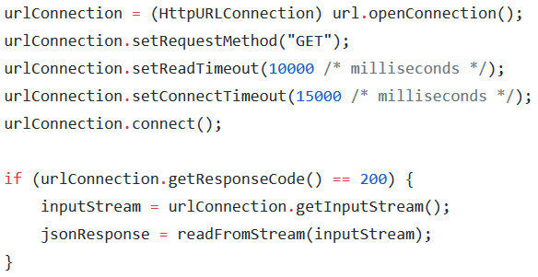
Making Http Request

Slide 7
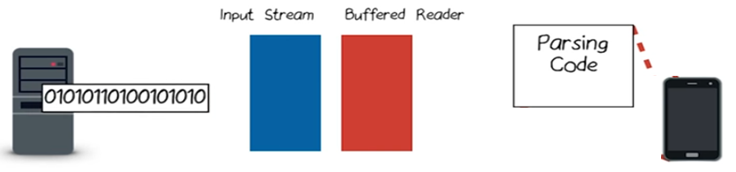
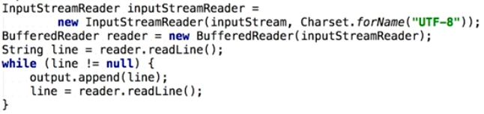
Reading From Input Stream

Slide 8
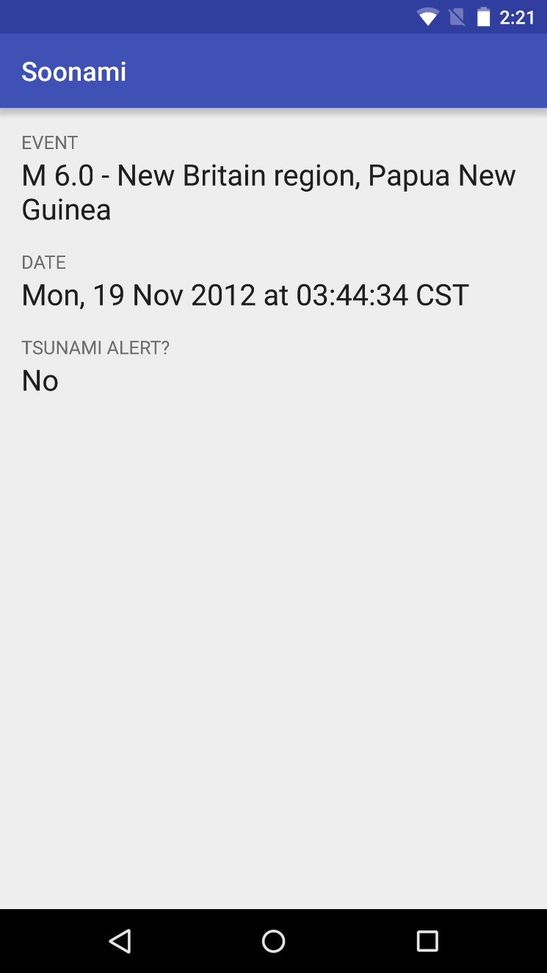
Soonami
Aplikasi contoh untuk belajar HTTP networking.
Download source code dari link berikut ini:
https://github.com/udacity/ ud843_Soonami

Slide 9

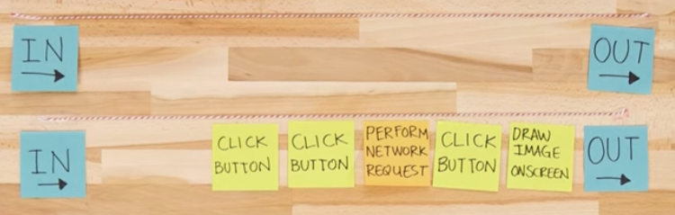
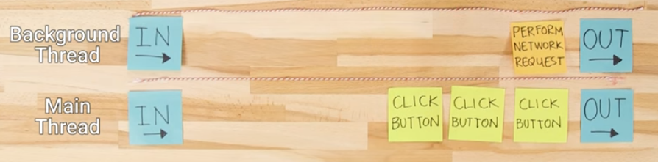

Main vs Background Threads

Slide 10
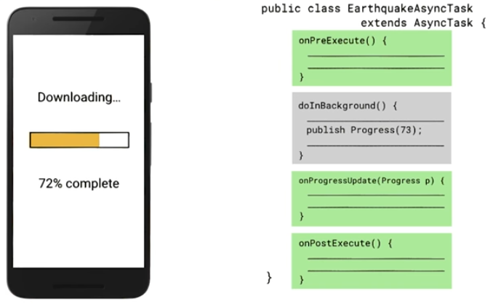
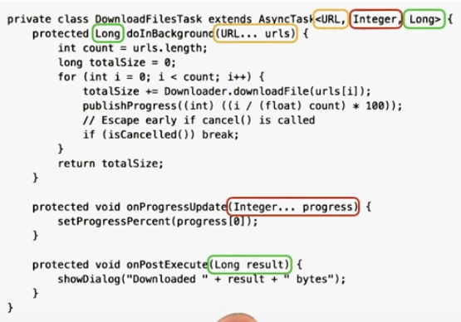

AsyncTask Callback Methods
https://developer.android.com/reference/android/os/AsyncTask.html

Slide 11
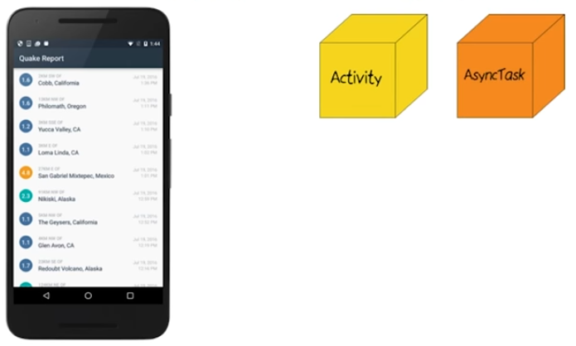


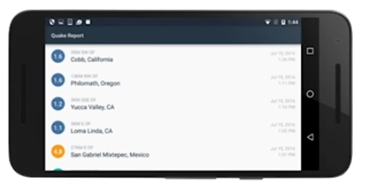

Limitations of AsyncTask
https://developer.android.com/guide/components/loaders.html

Slide 12
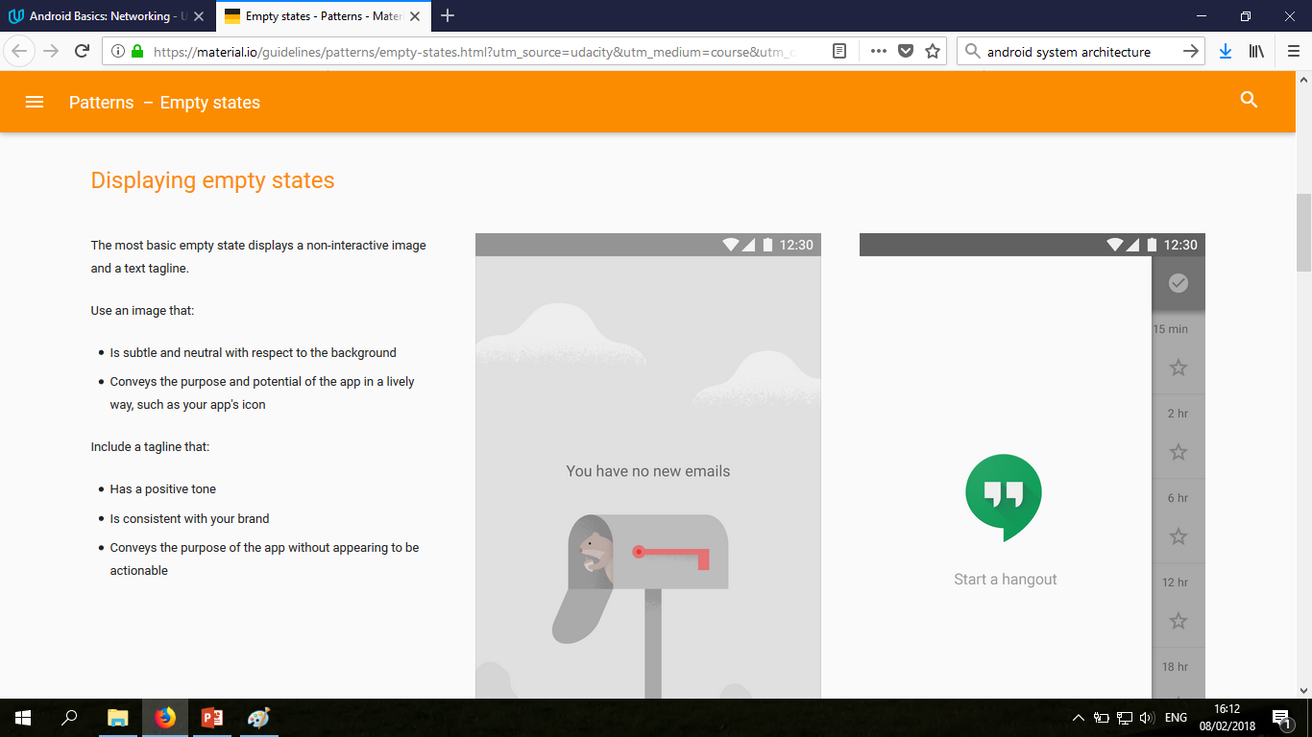
Empty State of the List
https://material.io/guidelines/patterns/empty-states.html

Slide 13
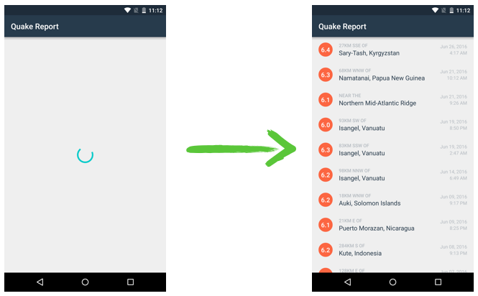
Loading Indicator

Slide 14
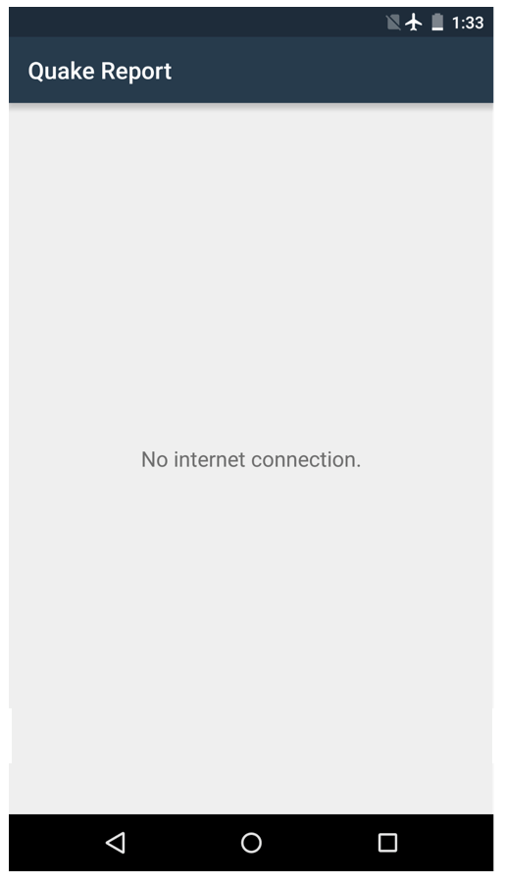
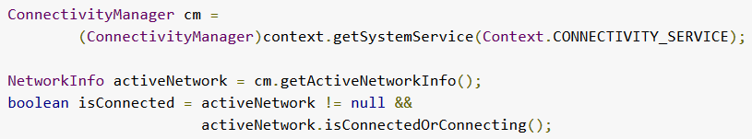
No Internet Connection
There's no need to schedule an update based on an Internet resource if you aren't connected to the Internet.

Slide 15
Referensi
Lesson 2: HTTP Networking
Lesson 3: Threads and Parallelism
Android Basics: Networking
https://www.udacity.com/course/ud843

